Slide 1

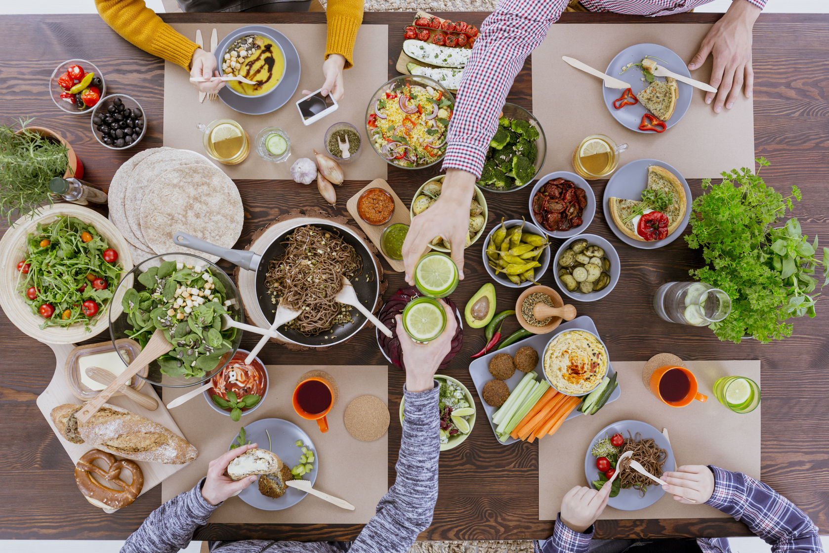

Food Preferences Survey Project
By/ Basmala Salama

Slide 2
Table of contents
Phase 1
Phase 2
Phase 3
The Proposal
The Questionnaire
Sampling and Pretests
Phase 4
Phase 5
Phase 6
Phase 7
Collect The Data
Expectation vs Real
Data Analysis
Report & Presentation

Slide 3

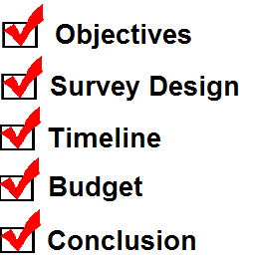


PHASE 1: Survey Proposal

Slide 4

Proposal Content
Objectives
The survey aims to use the data collected in developing new products or menu items that cater topeople’s preferences and dietary needs
Participants
The survey is to be conducted on a number of students from Alexandria University ranging from 500 or more students using an anonymous online platform.

Slide 5
Proposal Content
Survey Design
The survey is designed in the form of an online questionnaire of 20 – 30 questions. It is easy to complete and takes no more than 10 - 15 minutes.
Data Analysis
Data collected from the survey is analyzed using statistical computing tools like python/R.
Data is cleaned and prepared before analysis.

Slide 6
Proposal Content
Timeline
We expected that the survey timeframe would range from 5 to 7 weeks.
Budget
The costs of implementing a survey & the impact of alternative survey procedures on the costs of a survey & data collection.
Cost:- 500 - 1000 L.E.
Ethics and confidentiality
We ensure that participant’s privacy and rights are protected throughout the survey.

Slide 7

PHASE 2: Questionnaire

Slide 8
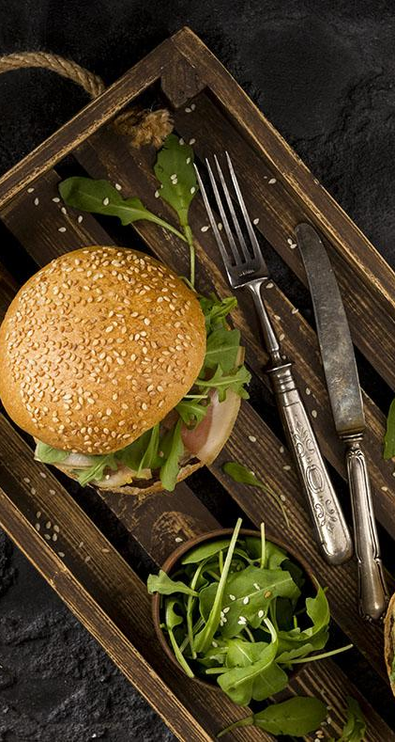
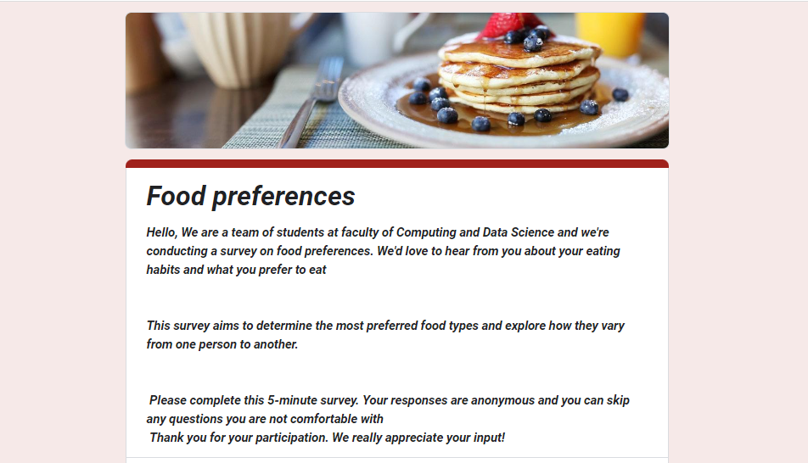
Questionnaire Design
Introduction

Slide 9
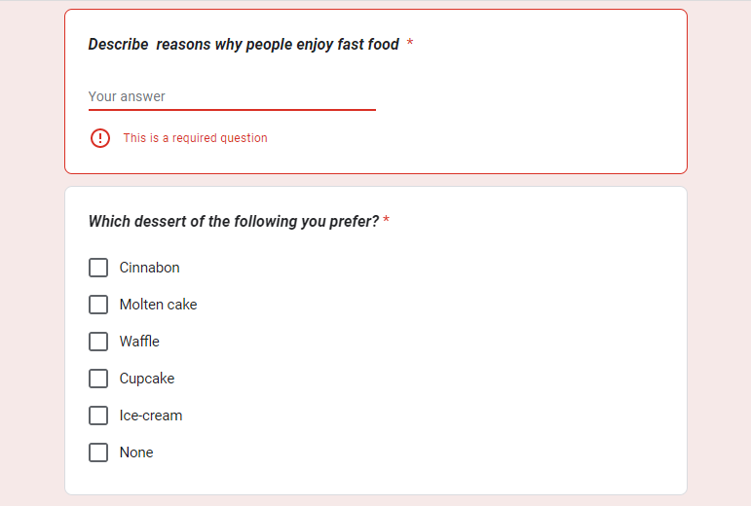
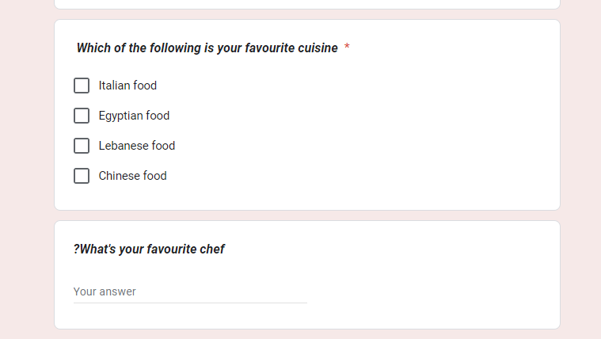
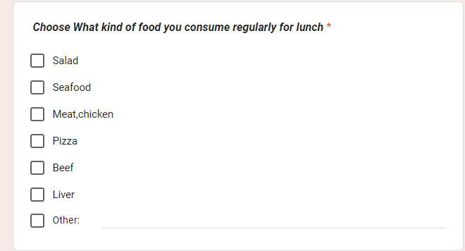
Main Survey Questions

Slide 10
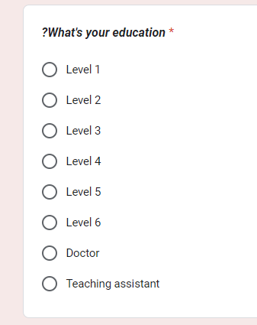
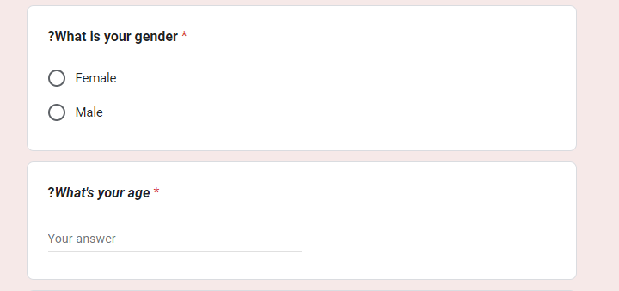
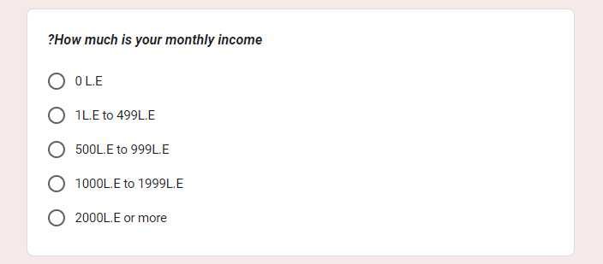
Demographic questions

Slide 11

PHASE 3: Sampling & Pretests

Slide 12

The questionnaire was provided by some questions for feedbacks where the students can express their opinions about our survey .
The number of responses we got were 107 responses.

Slide 13
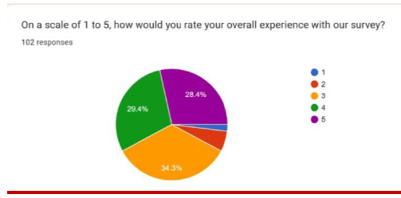
FEEDBACK RESPONSES

Slide 14
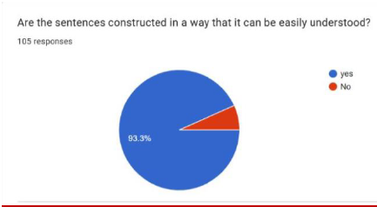
FEEDBACK RESPONSES

Slide 15
FEEDBACK RESPONSES
Some feedbacks limited into some modifications which we should do :
Some questions needed more options to choose
Some questions need no answer so "none" can be added to the choices.

Slide 16


Slide 17

PHASE 4: Data Preprocessing

Slide 18

We were able to collect like 527 responses from our population.
Collected data had missing values and was inconsistent.

Slide 19
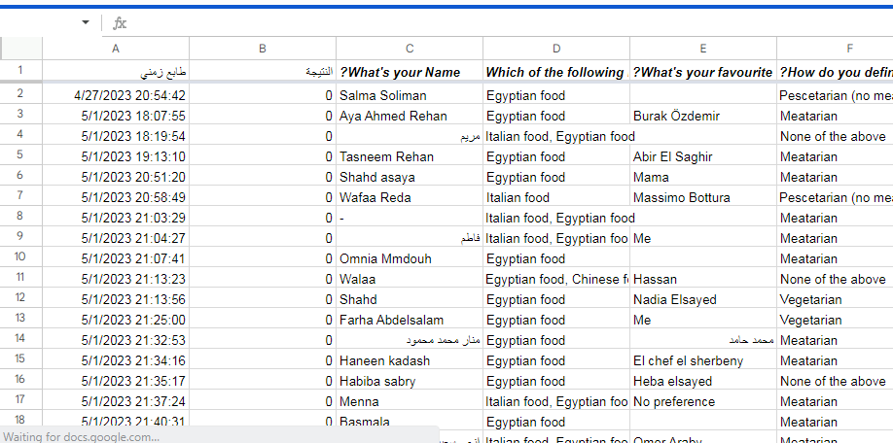
Data preproocessing Steps

Slide 20
Data preproocessing Steps
First, we had to deal with missing values and translate all arabic responses.
Second, We had to make sure that respondents didn’t answer the questions randomly.

Slide 21
Data preproocessing Steps
At last, we had to make sure that data is consistent and well framed so that it can used in the analysis.

Slide 22

PHASE 5: Expectation VS Real

Slide 23
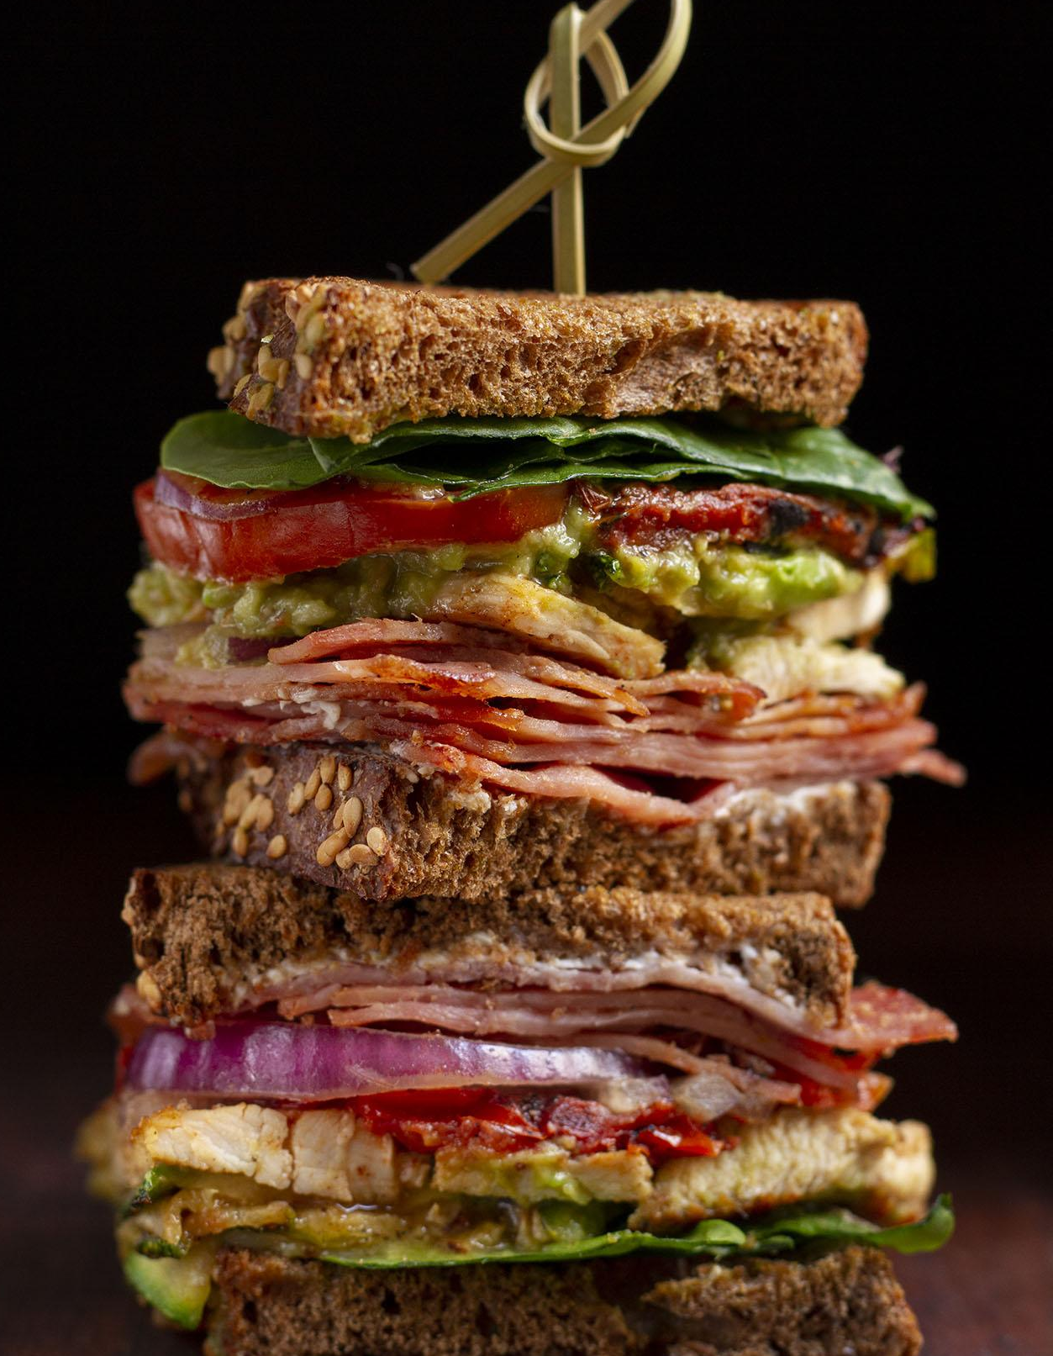
Part 1: Expectation vs Real
Total number of answered surveys is 527
Total number of responses taken in consideration is 300
Total number of non answered surveys is nearly 150 - 200

Slide 24
Part 2: Model Validation
We used SPSS program to measure Cronbach’s alpha for reliability
Cronbach’s alpha for our model is 0.533
How to solve this problem & increase alpha’s value

Slide 25

PHASE 6: Data Analysis

Slide 26
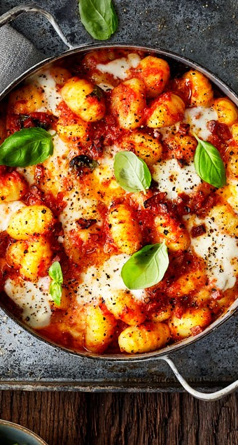
1st: Descriptive Statistics
mean for each kind of food cuisine is nearly 20-23% love Egyptian food , 53% of responses love Chinese food , 3% love Italian food, 3% love Lebanese food and others love all mentioned together. .

Slide 27
1st: Descriptive Statistics
median is 7 “ Chinese food “ :
that mean the middle value is “Chinese food”.
mode is 263 “ Egyptian food ” :
that means the max number of responses was to “Egyptian food”.

Slide 28
1st: Descriptive Statistics
standard deviation is 71.36 :
means that there are variation or dispersion
in data in the rate of 71.36 .
there is a relationship between Favourite_Cuisine and (Favourite_Chef , Shopping_Food )

Slide 29
2nd : Correlation Analysis
Correlation test :- The p-value of the test is 0.02348, which is less than the significance level alpha = 0.05. We can conclude that Diet and Age are significantly correlated with a correlation coefficient of 0.110407 and p-value of 0.02348

Slide 30
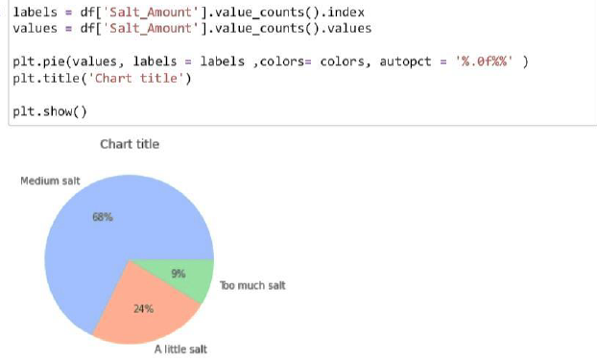
3rd : Data Visualization

Slide 31
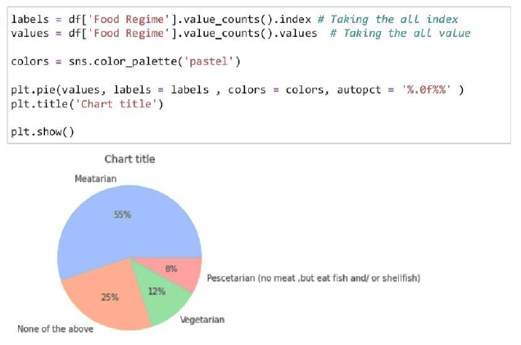
3rd : Data Visualization

Slide 32
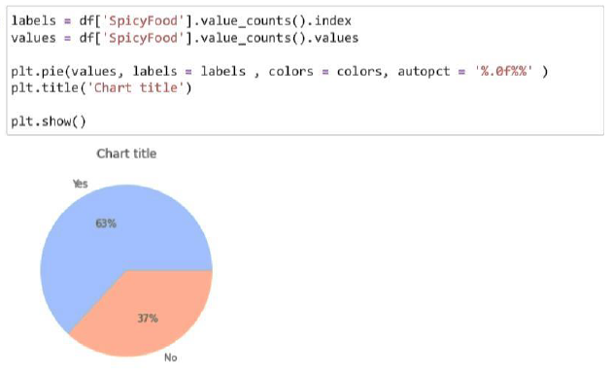
3rd : Data Visualization

Slide 33
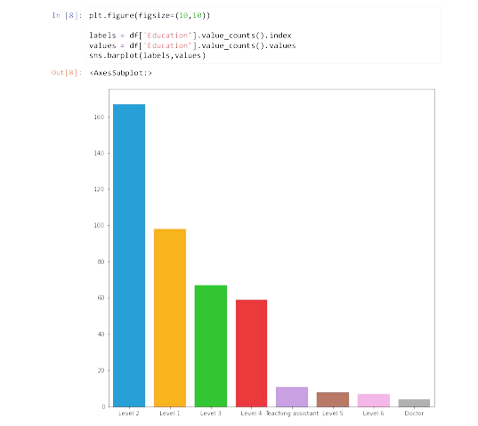
3rd : Data Visualization

Slide 34
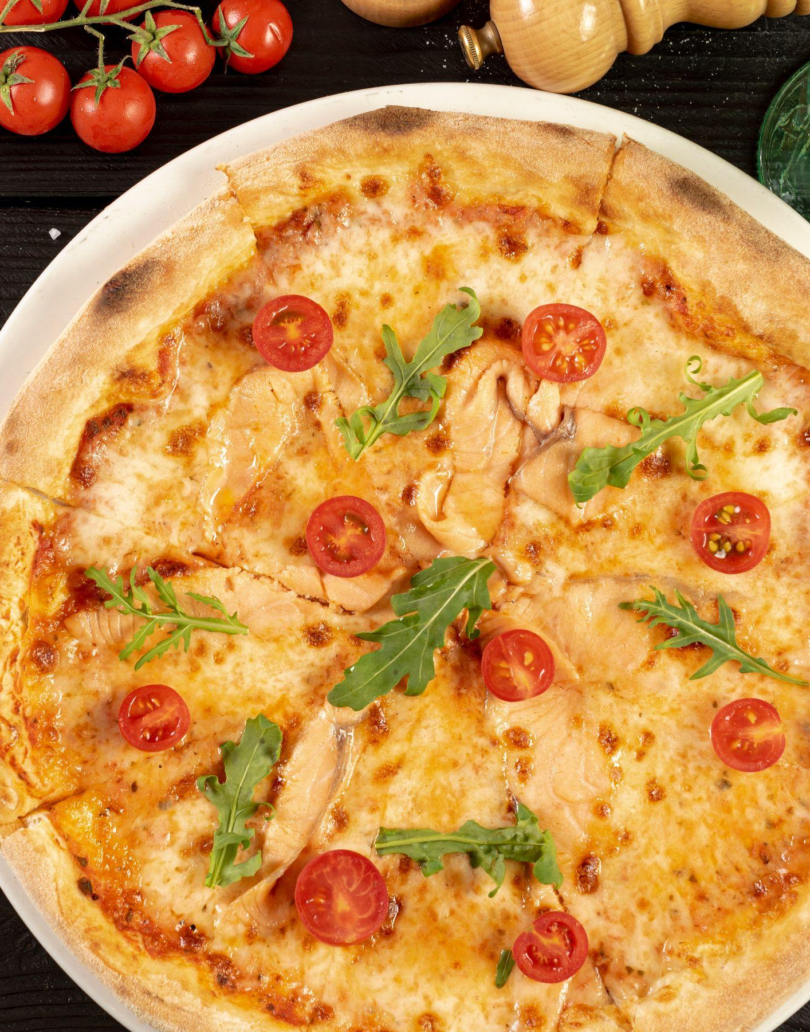
Thank You!

